Slide 1
COSC 3100 Brute Force and Exhaustive Search
Instructor: Tanvir

Slide 2
What is Brute Force?
The first algorithm design technique we shall explore
A straightforward approach to solving problem, usually based on problem statement and definitions of the concepts involved
“Force” comes from using computer power not intellectual power
In short, “brute force” means “Just do it!”

Slide 3
Brute Force Example
We want to compute a^{n} =
In RSA (Ron Rivest, Adi Shamir, and Leonard Adleman) encryption algorithm we need to compute a^{n} mod m for a > 1 and large n.
First response: Multiply 1 by a n times which is the “Brute Force” approach.
a × a × … … × a
n times

Slide 4
Why Brute Force ?
We have already seen two brute force algorithms:
Consecutive Integer Checking for gcd(m, n)
Definition based matrix-multiplication
It is the only general approach that always works
Seldom gives efficient solution, but one can easily improve the brute force version.
Usually can solve small sized instances of a problem
A yardstick to compare with more efficient ones

Slide 5
Brute force case studies
Given n orderable items (e.g., numbers, characters, etc.) how can you rearrange them in non-decreasing order?
Selection Sort:
On the i-th pass (i goes from 0 to n-2) the algo searches for the smallest item among the last n-i elements and swaps it with A_{i}
A₀ ≤ A₁ ≤ … ≤ A_{i-1} | A_{i}, ……, A_{min}, ……, A_{n-1}
already sorted
the last n-i elements

Slide 6
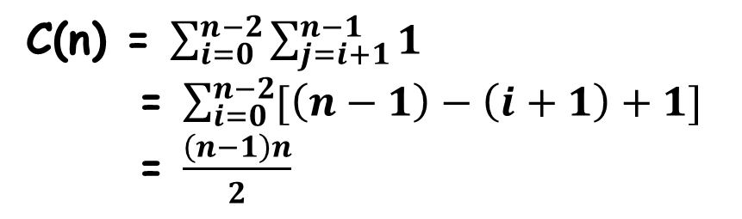
Brute Force: SelectionSort
ALGORITHM SelectionSort(A[0,..n-1])
for i <- 0 to n-2 do
min <- i
for j <- i+1 to n-1 do
if A[j] < A[min]
min <- j
swap A[i] and A[min]
| 89 45 68 90 29 34 17
17 | 45 68 90 29 34 89
17 29 | 68 90 45 34 89
17 29 34 45 | 90 68 89
17 29 34 45 68 | 90 89
Input size: n, basic op: “<”, does not
depend on type
17 29 34 45 68 89 | 90
C(n) = $\sum_{i=0}^{n−2}{\sum_{j=i+1}^{n−1}{1}}$
= $\sum_{i=0}^{n−2}{[\left(n−1\right)−\left(i+1\right)+1}]$
= $\frac{\left(n−1\right)n}{2}$
C(n) є Θ(n²)
# of key swaps є Θ(n)

Slide 7
Brute Force: Bubble Sort
Compare adjacent elements and exchange them if out of order
Essentially, it bubbles up the largest element to the last position
?
A₀, … …, A_{j} <-> A_{j+1}, … …, A_{n-i-1} | A_{n-i} ≤ … ≤ A_{n-1}

Slide 8
Brute Force: Bubble Sort (contd.)
ALGORITHM BubbleSort(A[0..n-1])
for i <- 0 to n-2 do
for j <- 0 to n-2-i do
if A[j+1] < A[j]
swap A[j] and A[j+1]
Could you improve
it?
What about 89, 45, 68, 90, 29, 34, 17 ?
C(n) є Θ(n²)
S_{worst}(n) = C(n)

Slide 9
Brute force case studies
We saw two brute-force approach to sorting.
Let’s see brute-force to searching
How would you search for a key, K in an array A[0..n-1]?

Slide 10
Sequential Search
ALGORITHM SequentialSearch(A[0..n-1], K)
//Output: index of the first element in A, whose //value is equal to K or -1 if no such element is found
i <- 0
while i < n and A[i] ≠ K do
i <- i+1
if i < n
return i
else
return -1
Input size: n
Basic op: <, ≠
C_{worst}(n) = 2n+2
Now we have brute-force, can
you improve it?

Slide 11
Sequential Search (contd.)
ALGORITHM SequentialSearch(A[0..n], K)
//Output: index of the first element in A, whose //value is equal to K or -1 if no such element is found
A[n] <- K
i <- 0
while A[i] ≠ K do
i <- i+1
if i < n
return i
else
return -1
Input size: n
Basic op: ≠
C_{worst}(n) = n+2
If you knew A to be sorted in
nondecreasing order, could you
improve the search?

Slide 12
Brute-force String Matching
Given a string of n characters (text) and a string of m (≤ n) characters (pattern), find a substring of the text that matches the pattern
Text: “nobody noticed him” pattern: “not”
t₀ … t_{i} … t_{i+j} … t_{i+m-1} … t_{n-1}
text
p₀ … p_{j} … p_{m-1}
pattern
p₀ should be tested with up to t?

Slide 13
Brute-force String Matching (contd.)
ALGORITHM BruteForceStringMatching(T[0..n-1], P[0..m-1])
for i <- 0 to n-m do
j <- 0
while j < m and P[j] = T[i+j] do
j <- j+1
if j = m
return i
return -1
Input size: n, m
Basic op: =
C_{worst}(n, m) = m(n-m+1) є O(nm)
C_{avg}(n, m) є Θ(n)
N O B O D Y _ N O T I C E D _ H I M
N O T
N O T
N O T
N O T
N O T
N O T
N O T
N O T
We shall learn more sophisticated and
efficient ones in space-time trade-off
chapter!

Slide 14
Closest-Pair by Brute-force
Find the two closest points in a set of n points
Points can be airplanes (most probable collision candidates), database records, DNA sequences, etc.
Cluster analysis: pick two points, if they are close enough they are in the same cluster, pick another point, and so on…

Slide 15
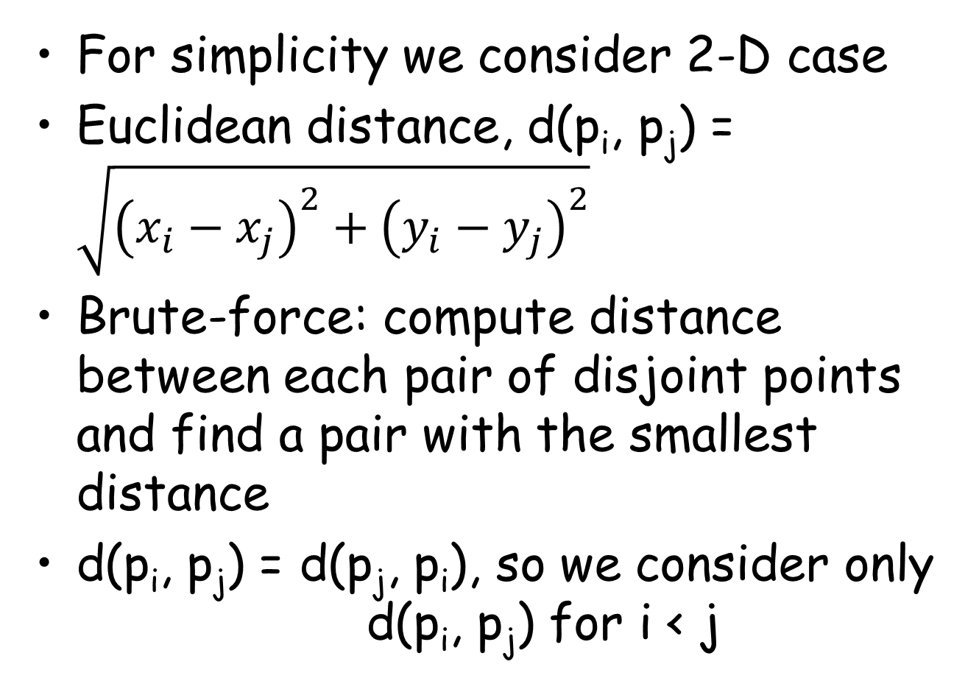
Closest-Pair by Brute-force
For simplicity we consider 2-D case
Euclidean distance, d(p_{i}, p_{j}) = $\sqrt{{\left(x_{i}−x_{j}\right)}^{2}+{\left(y_{i}−y_{j}\right)}^{2}}$
Brute-force: compute distance between each pair of disjoint points and find a pair with the smallest distance
d(p_{i}, p_{j}) = d(p_{j}, p_{i}), so we consider only d(p_{i}, p_{j}) for i < j

Slide 16
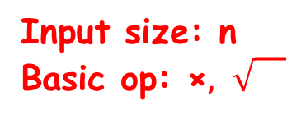
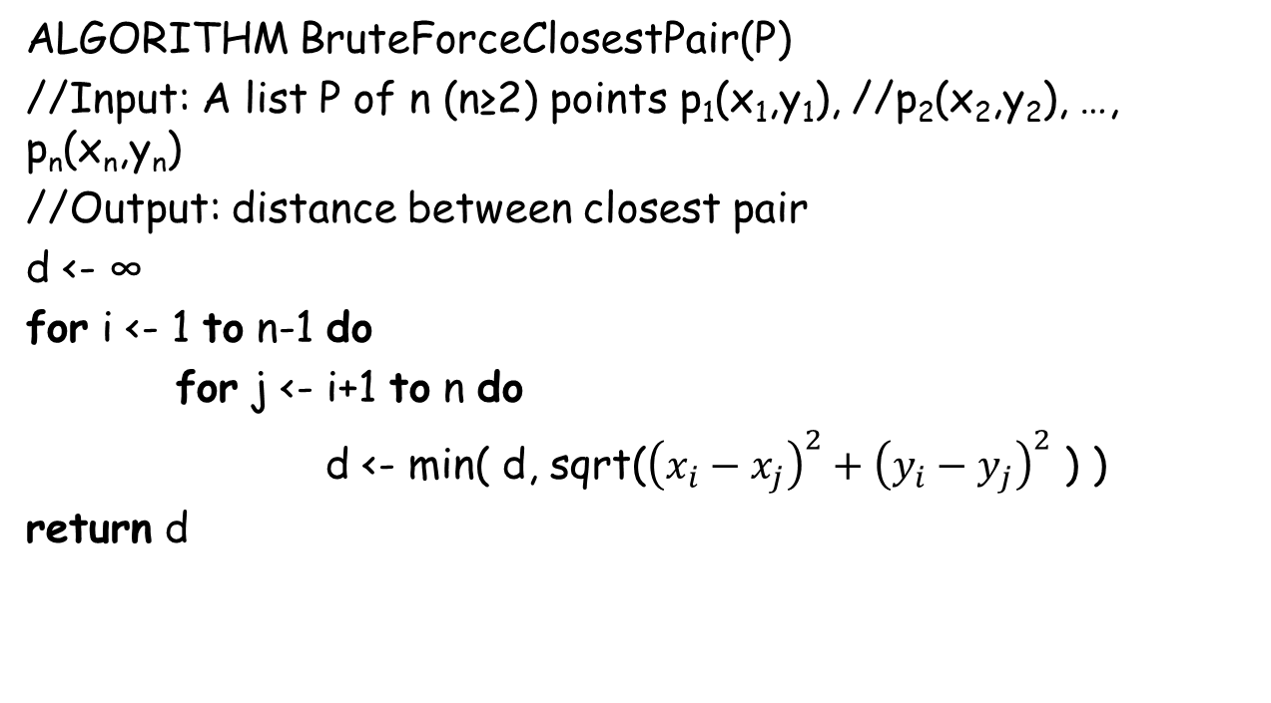
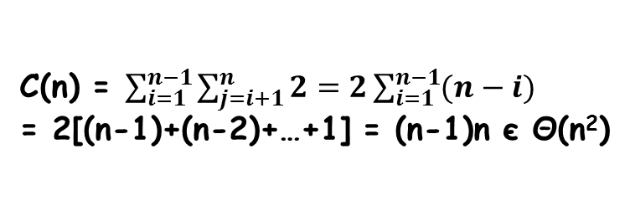

Closest-Pair by Brute-force (contd.)
ALGORITHM BruteForceClosestPair(P)
//Input: A list P of n (n≥2) points p₁(x₁,y₁), //p₂(x₂,y₂), …, p_{n}(x_{n},y_{n})
//Output: distance between closest pair
d <- ∞
for i <- 1 to n-1 do
for j <- i+1 to n do
d <- min( d, sqrt(${\left(x_{i}−x_{j}\right)}^{2}+{\left(y_{i}−y_{j}\right)}^{2}$ ) )
return d
In Divide & Conquer
we shall see linearithmic
version!
Input size: n
Basic op: ×$, \sqrt{}$
Get rid of
C(n) = $\sum_{i=1}^{n−1}{\sum_{j=i+1}^{n}{2}}=2\sum_{i=1}^{n−1}{(n−i)}$
= 2[(n-1)+(n-2)+…+1] = (n-1)n є Θ(n²)
expensive!

Slide 17
Convex-hull Problem by Brute-force
One of the most important problem in computational geometry
Convex hulls give convenient approximation of object shapes
In animation, collision detection

Slide 18
Convex-hull (contd.)
DEFINITION: A set of points in the plane is called convex if for any two points p and q in the set, the entire line segment with the endpoints at p and q belongs to the set.
convex
Not convex

Slide 19
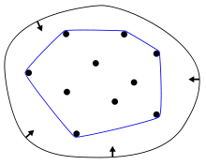
Convex-hull (contd.)
DEFINITION: The convex hull of a set S of points is the smallest convex set containing S.
The “smallest” requirement means that the convex hull of S must be a subset of any convex set containing S.

Slide 20
Convex-hull (contd.)
THEOREM: The convex hull of any set S of n > 2 points not all on the same line is a convex polygon with the vertices at some of the points of S.
Vertices of the polygon are called extreme points.
We need to know which pairs of points need to be connected.

Slide 21
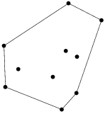
Convex hull (contd.)
How can we solve the convex hull problem ?
P_{i} and p_{j} are on the boundary
if and only if all other points
lie at the same side of the line
segment between p_{i} and p_{j}
Check
sign of
ax+by-c
p_{i}
p_{j}
What’s the time
efficiency?
ax+by=c
O(n³)

Slide 22
Summary of Brute Force
Just solve it!
Improve it later.

Slide 23
Exhaustive Search
Traveling Salesman Problem (TSP)
Find the shortest tour through a given set of n cities that visits each city exactly once before returning to the city where it started
Can be conveniently modeled by a weighted graph; vertices are cities and edge weights are distances
Same as finding “Hamiltonian Circuit”: find a cycle that passes through all vertices exactly once

Slide 24

Exhaustive Search: TSP (contd.)
Hamiltonian circuit: A sequence of n+1 adjacent vertices $v_{i_{0}},v_{i_{1}}$, …, $v_{i_{n−1}}$, $v_{i_{0}}$
How can we solve TSP?
Get all tours by generating all permutations
of n-1 intermediate cities, compute the tour
lengths, and find the shortest among them.

Slide 25

Traveling Salesman (TSP)
2
a
b
Consider only when b precedes c
5
3
$\frac{1}{2}$(n-1)! permutations
8
7
c
d
1
a → b → c → d → a
2+8+1+7 = 18
a → b → d → c → a
2+3+1+5 = 11
optimal
a → c → b → d → a
5+8+3+7 = 23
a → c → d → b → a
5+1+3+2 = 11
optimal
a → d → b → c → a
7+3+8+5 = 23
a → d → c → b → a
7+1+8+2 = 18

Slide 26
Exhaustive Search: Knapsack problem
Given n items of weights w₁, w₂, …, w_{n} and values v₁, v₂, …, v_{n} and a knapsack of capacity W, find the most valuable subset of the items that fit into the knapsack
A transport plane has to deliver the most valuable set of items to a remote location without exceeding its capacity
How can we solve it ?

Slide 27
Knapsack problem (contd.)
Brute force: Generate all possible subsets of the n items, compute total weight of each subset to identify feasible subsets, and find the subset of the largest value
What is the time efficiency ?
Ω(2^{n})

Slide 28
Knapsack problem (contd.)
subset | weight | value
Ø | 0 | $0
{1} | 7 | $42
{2} | 3 | $12
{3} | 4 | $40
{4} | 5 | $25
{1,2} | 10 | $54
{1,3} | 11 | !feasible
{1,4} | 12 | !feasible
{2,3} | 7 | $52
{2,4} | 8 | $37
{3,4} | 9 | $65
{1,2,3} | 14 | !feasible
{1,2,4} | 15 | !feasible
{1,3,4} | 16 | !feasible
{2,3,4} | 12 | !feasible
{1,2,3,4} | 19 | !feasible
W=10
w₁ = 7
v₁ = $42
w₂ = 3
v₂ = $12
knapsack
Item 1
Item 2
How about
taking items
in decreasing order
of value/weight?
w₄ = 5
v₄ = $25
w₃ = 4
v₃ = $40
Item 3
Item 4
Works for this example! ☺

Slide 29
Knapsack problem (contd.)
W=50
w₁ = 30
v₁ = $120
w₂ = 20
v₂ = $100
w₃ = 10
v₃ = $60
knapsack
Item 1
Item 2
Item 3
Item 1: $4/unit
Item 2: $5/unit
Item3: $6/unit
{Item3, Item2} = $60+$100 = $160
{Item3, Item1} = $60+$120 = $180
{Item2, Item1} = $100+$120 = $220
Doesn’t work for this example ☹

Slide 30
Exhaustive Search
A brute force approach to combinatorial problems (which require generation of permutations, or subsets)
Generate every element of problem domain
Select feasible ones (the ones that satisfy constraints)
Find the desired one (the one that optimizes some objective function)

Slide 31
Exhaustive Search (contd.)
For both Traveling Salesman and Knapsack problems, exhaustive search gives exponential time complexity.
These are NP-hard problems, no known polynomial-time algorithm
Most famous unsolved problem in Computer Science: P vs. NP problem (look at wiki).
Will see in more details in “limitation” chapter

Slide 32
Exhaustive Search: Assignment Problem
There are n people who need to be assigned to execute n jobs, one person per job.
C[i, j] : cost that would accrue if i-th person is assigned to j-th job.
Find an assignment with the minimum total cost.

Slide 33
Assignment problem (contd.)
 | Job 1 | Job 2 | Job 3 | Job 4
Person 1 | 9 | 2 | 7 | 8
Person 2 | 6 | 4 | 3 | 7
Person 3 | 5 | 8 | 1 | 8
Person 4 | 7 | 6 | 9 | 4
Select one element in each row
so that all selected elements are
in different columns and total sum
of the selected elements is the smallest.
Cost matrix
<j₁, j₂, …, j_{n}> are feasible solution tuples
i-th component indicates the column of
the element selected in i-th row
e.g., <2, 3, 4, 1>
Generate all permutations of <1, 2, 3, 4>
And compute total cost, find the smallest cost.

Slide 34
Assignment problem (contd.)
2 7 8
4 3 7
8 1 8
7 6 9 4
C =
Complexity is Ω(n!)
Efficient algo exists
Called the “Hungarian
method”.
< 1, 2, 3, 4 > cost = 9+4+1+4 = 18
< 1, 2, 4, 3 > cost = 9+4+8+9 = 30
And so on…

Slide 35
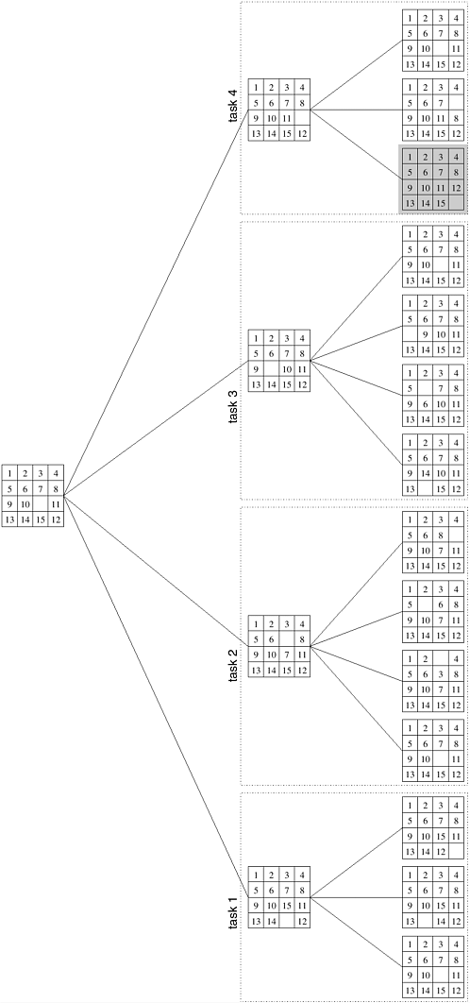
Exhaustive Search (contd.)
Problem domain
could be in the form
of a graph.
Then we have to traverse
the graph.

Slide 36
Graph Traversals
Problem domain can be a graph
Exhaustive search needs to visit each vertex and do something at it
Two important graph-traversal algorithms: depth-first search, breadth first search

Slide 37
Depth-first search
Start at a vertex, mark it as visited
Go to one of unvisited neighbors, mark it visited, and so on.
At dead end, backs up one edge to the vertex it came from and tries to visit unvisited vertices from there.
Eventually halts after backing up to the starting vertex, by then one connected component has been traversed.
If unvisited vertices remain, dfs starts at one of them.

Slide 38
Depth-first Search (contd.)
g
h
Tree edge
Back edge
Depth first search forest
a
e
c
f
d
b
j
i
Which data structure to use ?

Slide 39
Depth-first Search (contd.)
How to decide if the graph is connected?
Start a DFS traversal at an arbitrary vertex
and check, after the traversal halts, whether
all the vertices of the graph will have been visited.
How to decide if the graph acyclic?
If no back edges, acyclic.

Slide 40
Depth-first Search (contd.)
ALGORITHM: DFS(G)
// Input: Graph=<V, E>
mark each vertex in V with 0 as a mark of being “unvisited”
count <- 0
for each vertex v in V do
if v is marked with 0
dfs(v)
dfs(v)
count <- count+1; mark v with count
for each vertex w in V adjacent to v do
if w is marked with 0
dfs(w)
Traversal time is in Θ(|V|²)
Or in Θ(|V| + |E|)
Adjacency matrix
Adjacency list

Slide 41
Breadth-first Search
Start at a vertex, mark it visited
Go to each of its neighbors and put them in a list
Delete the starting vertex.
Start at one of the remaining in the list, mark it visited, and so on...

Slide 42
Breadth-first Search (contd.)
g
h
Tree edges
Cross edges
Breadth-first search forest
a
e
c
f
d
b
j
i
Which data structure to use ?

Slide 43
BFS (contd.)
ALGORITHM BFS(G)
mark each vertex in V with 0 as a mark of being “unvisited”
count <- 0
for each vertex v in V do
if v is marked with 0
bfs(v)
bfs(v)
Count <- count+1; mark v with count and initialize a queue with v
while the queue is not empty do
for each vertex w in V adjacent to the front vertex do
if w is marked with 0
count <- count+1; mark w with count
add w to queue
remove the front vertex from the queue
Time complexity is similar
to DFS
Gives shortest path between
two vertices

Slide 44
Summary of DFS and BFS
 | DFS | BFS
Data structure | Stack | Queue
Edge types | Tree and back edges | Tree and cross edges
Applications | Connectivity, Acyclicity, Articulation points | Connectivity, Acyclicity, Minimum-edge paths
Efficiency for adjacency matrix | Θ(|V|²) | Θ(|V|²)
Efficiency for adjacency list | Θ(|V| + |E|) | Θ(|V| + |E|)

